Slide 1
Programming in C++
https://fan1x.github.io/cpp21.html
tomas.faltin@matfyz.cuni.cz

Slide 2
Programming in C++ - lab 13
https://fan1x.github.io/cpp22.html
tomas.faltin@matfyz.cuni.cz

Slide 3
Reminder
Software project
POC: 05/03/2023 (postponed)
First submission: 02/04/2023
Final submission: 28/05/2023

Slide 4
Feedback: Calculator
Add tests for all special cases from code (-1p)
E.g., 3 / 0, 3 / 2.3, 1 + 2 * 3.3
Test in clean environment (-1p)
Redownload and build
Warnings (-1p)
Not OOP (-1p)

Slide 5
Kahoot

Slide 6
Programming in C++ - lab 12
https://fan1x.github.io/cpp21.html
tomas.faltin@matfyz.cuni.cz

Slide 7
Reminder
Two large homeworks in ReCodex (total 40 points)
Points are included in the final score from the course
Larger HW – 25 points, 29/11 → 23/12
Software project
Topic must be approved by 27/11/2022
POC: 05/03/2023 (postponed)
First submission: 02/04/2023
Final submission: 28/05/2023

Slide 8
Feedback: Data Aggregation
Memory leak when manual allocation – use smart pointers
Problems with the large tests
std::vector<vector<Base *>> vs. std::vector<BaseVector *>

Slide 9
Exceptions
Predefined types in <stdexcept>
Create your own type through inheritance
Use RAII
template<typename T> class matrix {
public:
T &get(size_t x, size_t y) {
if (!is_valid_range(x, y)) {
throw std::out_of_range("Invalid x or y value");
}
}
};
matrix<int> mi;
try {
cout << mi.get(10, 10);
} catch (const std::out_of_range &e) {
cerr << e.what() << endl;
}

Slide 10
Regexp
<regex>
Regular expressions in C++

Slide 11
HW1: Problem With Large Tests
std::vector<vector<Base *>>

Slide 12
Programming in C++ - lab 11
https://fan1x.github.io/cpp21.html
tomas.faltin@matfyz.cuni.cz

Slide 13
Reminder
Two large homeworks in ReCodex (total 40 points)
Points are included in the final score from the course
Larger HW – 25 points, 29/11 → 23/12
Software project
Topic must be approved by 27/11/2022
POC: 05/03/2023 (postponed)
First submission: 02/04/2023
Final submission: 28/05/2023

Slide 14
Feedback: Data Aggregation
-5 points: missed deadline
-2 points
Not having virtual destructor with inheritance
Large tests not working
-1 point
Using const function for read only methods
Using const references for large objects
Warnings
Large functions
procedural code
no classes/objects

Slide 15
Streams
<iostream>
I/O
<fstream>
Work with files
<sstream>
Work with std::string

Slide 16
Homework – A Simple Text Editor
Open/Edit/Save a file
Print a directory
<filesystem>

Slide 17
Programming in C++ - lab 10
https://fan1x.github.io/cpp21.html
tomas.faltin@matfyz.cuni.cz

Slide 18
Reminder
Two large homeworks in ReCodex (total 40 points)
Points are included in the final score from the course
Smaller HW – 15 points, 15/11 → 5/12
Larger HW – 25 points, 29/11 → 23/12
Software project
Topic must be approved by 27/11/2022
POC: 05/03/2023 (postponed)
First submission: 02/04/2023
Final submission: 28/05/2023

Slide 19
2nd Large homework: Calculator
Deadline: 23/12/20223​ 23:59
25 points
Functionality: 15 points
Tests & code culture: 10 points
2/3 of points gained for functionality
-10 points per each week (even if partial)

Slide 20
Piškvorky feedback

Slide 21
Templates

Slide 22
Template Functions
class complex {
int real_; int im_; public: int &re() { return real_; } int re() const { return real_; }; int &im() { return im_; }; int im() const { return im_; }; };
void print(int v) { cout << v; } void print(double v) { cout << v; }
void print(const string &str) { cout << str; }
int main() {
complex c;
print(c.re());
}
template<typename T> class complex { T real_; T im_; public: T &re() { return real_; } T re() const { return real_; }; T &im() { return im_; }; T im() const { return im_; }; };
template<class T>
void print(const T &v) { cout << v; }
int main() {
complex<int> c;
print(c.re());
}

Slide 23
Template Classes
template<class Cont> class container_wrapper { Cont cont; public: void push_back(const typename Cont::value_type& val) { cont.push_back(val); } void push_back(typename Cont::value_type &&rval) { cont.push_back(std::move(rval)); } }; template<class Cont> auto make_wrapper() { return container_holder<Cont>(); }
auto vector_wrapper = make_wrapper<std::vector<int>>();
vector_wrapper.push_back(3);

Slide 24
Homework – vector<T>
Generic vector
Mandatory operations
default ctor, ctor(size_t, value_type), copy/move ctor/assignment
size(), capacity(), reserve(), push_back(), operator[]()

Slide 25
Programming in C++ - lab 9
https://fan1x.github.io/cpp21.html
tomas.faltin@matfyz.cuni.cz

Slide 26
Improvements And Feedback
Online Feedback

Slide 27
Reminder
Two large homeworks in ReCodex (total 40 points)
Points are included in the final score from the course
Smaller HW – 15 points, 15/11 → 5/12
Larger HW – 25 points, 29/11 → 23/12
Software project
Topic must be approved by 27/11/2022
POC: 05/03/2023 (postponed)
First submission: 02/04/2023
Final submission: 28/05/2023

Slide 28
Iterators
A class used for traversing and accessing containers (vector, map, …)
Act like pointers
Holds a position and points to an object inside the container
Different types of iterators (input, forward, bidirection, random, …)
Iterators on containers supports at least: *, ++, !=
begin() – returns an iterator to the first element
end() - returns an iterator pointing past the last element

Slide 29

Lambdas
An unnamed function object (”in-place function”)
[capture](par1, par2, …) { /* function body */ };
capture: things passed from outside function
Passing by reference (&), otherwise by copy
Can define a new variable
~ Anonymous functor
Returning from function through templates/auto
lambda
functor

Slide 30
Functors
A special object behaving like a function
Defines operator()
Can hold its state

Slide 31
Algorithms
#include <algorithm>
A library defining functions for variaty of purposes
sort, make_heap, set_intersection
Define range through iterators
Anything iterator-like (iterators, pointers, …)
Define action through function/functor/lambda
Anything function-like (functions, functors, …)
☺ ranges

Slide 32
Homeworks: Fix Previous Homeworks Using Algorithms
Dictionary (ex06)
Simple People Database (ex06, Recodex)
Add a function that can do multiple things through a single iteration
Use functors (or somethings similar)
Gather min, max, sum, avg, …
Sorting in Polymorphic Vector

Slide 33
Programming in C++ - lab 8
https://fan1x.github.io/cpp21.html
tomas.faltin@matfyz.cuni.cz

Slide 34
Improvements And Feedback
Online Feedback

Slide 35
Homework Discussion

Slide 36
Reminder
Two large homeworks in ReCodex (total 40 points)
Points are included in the final score from the course
Smaller HW – 15 points, 15/11 → 5/12
Larger HW – 25 points, most probably 29/11 → 23/12
Ping me if you want to start sooner
Software project
Topic must be approved by 27/11/2022
POC: 18/12/2022
First submission: 02/04/2023
Final submission: 28/05/2023

Slide 37
Data Aggregation - Hints
Download example input+output and debug locally
PRG.exe < input_file.txt > output_file.txt
Check logs what’s wrong
Write your own tests!
(get inspired by ReCodex’s tests)
Time & memory limits
Store necessary things once
Use observers (pointers, references) instead
Use proper types
Don’t store numbers as string
Avoid copying – const &

Slide 38
Functions As Parameter – std::function
std::function<RET(PAR1, PAR2,…)>
void for_each(const std::vector<int> &vi,
const std::function<void(int)> &fn) {
for (int x : vi) {
fn(x);
}
}
void print(int x) { cout << x << endl; }
int main(int argc, char* argv[]) {
vector<int> vi{1, 2, 3, 4, 5, 6};
for_each(vi, print);
}

Slide 39
Function As Parameter – Other Options
Lambdas
Templates
Function pointers/references
☹ C-style

Slide 40
Inheritance
To inherit (=use) attributes and methods of the ancestor class
class container {
public:
using size_type = size_t;
size_t size() const { return size_; }
protected:
size_t size_t;
};
class vector_int : public container { ... };
class list_int : public container { ... };
int main() {
vector_int vi;
cout << vi.size();
}

Slide 41
Inheritance Examples
class car {};
class volvo : public car {};
class skoda : public car {};
class animal {};
class dog : public animal {};
class cat : public animal {};
class employee {};
class accountant : public employee {};
class expression {};
class binary : public expression {};
class plus : public binary {};
class object {}; // JAVA
class XYZ : public object {};
expression
unary
binary
value
minus
minus
plus

Slide 42
Inheritance Vs. Composition
Inheritance – logical hierarchy
Composition – no logical hierarchy
Can be implemented through inheritance
vehicle
car
wheel
bike
volvo
skoda

Slide 43
Inheritance Comments
Think about the API
Hide type specific things inside methods/functions
if-else → bad design

Slide 44
Polymorphism
Base class acts(=works) as the (internally stored) derived class
Function must be virtual and gets called via reference/pointer
class base {
protected:
int value = 0;
public:
virtual ~base() = default;
virtual void print() const { std::cout << "base: " << value; }
};
class derived : public base {
public:
void print() const override { std::cout << "derived: " << value; }
};
int main() {
derived d;
d.print(); // derived: 0
base &b = d;
b.print(); // derived: 0
base *b_ptr = &d;
b_ptr->print(); // derived: 0 base b2 = d;
b2.print(); // base: 0
}

Slide 45
Homework: Polymorphic Vector
Create a vector which can store different types
int, double, string
Use inheritance (no union, variant, …)
Dynamic allocation
// API
// insert a value
push_back(value); // print the value of i-th element
print(size_type i);
// print all values inside the array print_all();
int main() {
my_vec v;
v.push_back(1); v.push_back(2.3); v.push_back(“four”);
v.print(0); // 1
v.print(2); // “four”
v.print_all(); // [1, 2.3, “four”]
}

Slide 46
Programming in C++ - lab 6
https://fan1x.github.io/cpp21.html
tomas.faltin@matfyz.cuni.cz

Slide 47
Reminder
Two large homeworks in ReCodex (total 40 points)
Points are included in the final score from the course
Smaller HW – 15 points, assigned 15/11
Larger HW – 25 points, ~December
Software project
Topic must be approved by 27/11/2022
POC: 18/12/2022
First submission: 02/04/2023
Final submission: 28/05/2023

Slide 48
Homework1 Solution

Slide 49
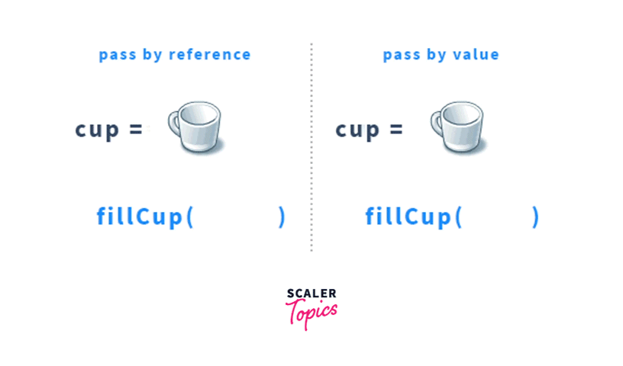
Returning A (Const) Reference
To give an access to data inside an object
E.g., getters, operator=(), …
The returned data lives even after end of the function

Slide 50
Returning A (Const) Reference - Example
class complex_double {
double im;
double re;
public:
explicit complex_double(double re, double im = 0.0) {
this->im = im;
this->re = re;
}
double &real_part() {
return re;
}
double real_part() const {
return re;
}
double &imaginary_part() {
return im;
}
double imaginary_part() const {
return im;
}
};
int main() {
complex_double cd(1, 2);
cout << '{' << cd.real_part()
<< ',' << cd.imaginary_part() << '}' << endl;
cd.imaginary_part() = 0;
cout << '{' << cd.real_part()
<< ',' << cd.imaginary_part() << '}' << endl;
}

Slide 51
Containers
std::vector<Type> - dynamic array
my_vec[idx] = value, push_back(), …
std::array<Type, Size> - fixed size array
my_array[idx] = value, …
std::deque<Type> - double ended dynamic queue/array
push_back(), push_front(), back(), front(), …
std::list<Type> - linked list
std::map<Key,Value>, std::unordered_map<Key, Value> - map
my_map[key] = value, find(), insert(), …
std::set<Key>, std::unordered_set<Key> - set
contains(), insert(), find(), …

Slide 52
Homework1: Dictionary
// An example of API
class Dictionary {
// Insert a new language and returns its ID
size_t add_language(const string &name);
// Insert new words into a dictionary
bool add_vocabulary(size_t words1_language_id, const string &word1,
size_t words2_language_id, const string &word2);
// Translate a given text with the given language into the output language
string translate(size_t input_language_id, const string &text,
size_t output_language_id) const;
// Automatically translate a given text into a given language
string translate(const string &text, size_t output_language_id) const;
// Return all vocabularies for a given language
const vector<string> &all_vocabulary(size_t language_id) const;
};

Slide 53
Homework2: Simple People Database
In Recodex: https://recodex.mff.cuni.cz/
Deadline: Monday 13:00
NOT the official large homework
Just to test your knowledge and the access to the ReCodex

Slide 54
Programming in C++ - lab 7
https://fan1x.github.io/cpp21.html
tomas.faltin@matfyz.cuni.cz

Slide 55
Homework Discussion

Slide 56
Reminder
Two large homeworks in ReCodex (total 40 points)
Points are included in the final score from the course
Smaller HW – 15 points, 15/11 → 5/12
Larger HW – 25 points, most probably 29/11 → 23/12
Ping me if you want to start sooner
Software project
Topic must be approved by 27/11/2022
POC: 18/12/2022
First submission: 02/04/2023
Final submission: 28/05/2023

Slide 57
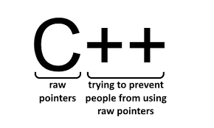

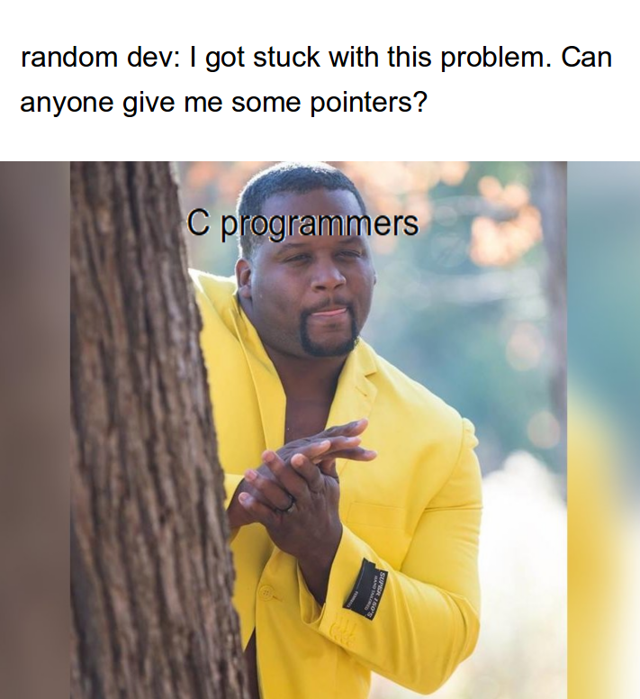
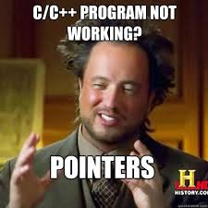
Pointers

Slide 58

Dynamic Allocation
Use smart pointers (no raw pointers, i.e., no new/new[])
Single owner
Most common case
Passing the ownership - move only, no copy
unique_ptr<T>
Shared ownership (multiple owners)
shared_ptr<T>
weak_ptr<T> // to break the cycle
Creation: make_unique<T>, make_shared<T>
Allocation of consecutive memory (~array)
make_unique<int[10]>()

Slide 59
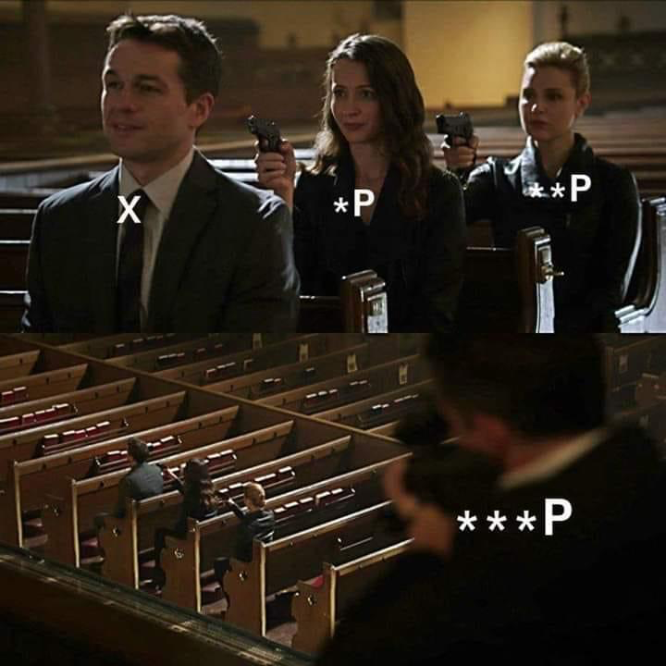
Observers
Working with the pointer with no changes to ownership
Returned type is a (const) pointer
Smart pointers - get()
Observer ~ Address
Getting an address: &x
To access the values through a pointer
operator*(), operator->()

Slide 60
Owners And Observers: Quick Rules
Owner → unique_ptr<T>, shared_ptr<T>
Modifying observer → T * (pointer)
Read-only observer → const T *
Getting an observer
smart pointers → get()
otherwise → & (observer ~ address)
Accessing the value
access the value directly → *
access member attribute → -> (same as doing (*var).
Pointing to nothing → nullptr
*
value
pointer
&
owner

Slide 61
Pointers In Memory
int main() { int i = 2; int *pi = &i; int **ppi = &pi; cout << i; // 2 cout << pi; // ..00 cout << *pi; // 2 cout << ppi; // ..04 cout << *ppi; // ..00 cout << **ppi; // 2 }
Q: What if we call cout << *i?
Q: Is there a difference between static and dynamic allocation?
Address | Value | (Variable)
....
..00 | 2 | i
..02
..04 | ..00 | pi
..06
..08 | ..04 | ppi
..0a
....
operator*
*
**
*

Slide 62
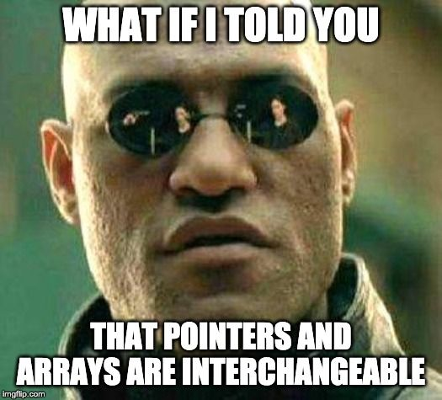
Pointer Arithmetic
Takes type into account
unique_ptr<int[]> int_arr = make_unique<int[]>(10);
for (size_t i = 0; i < 10; ++i) { int_arr[i] = 0; }
int *ptr = int_arr.get();
(*ptr) = 1;
*(ptr + 1) = 2;
cout << *ptr << ' ' << *(ptr + 1) << endl; // 1 2
ptr += 1;
cout << *ptr++ << endl; // 2
cout << *ptr << ' ' << *(ptr - 1) << endl; // 0 2
*ptr-- = 3;
cout << ptr[-1] << ' ' << ptr[0] << ' ' << ptr[1] << endl; // 1 2 3

Slide 63
Notes On Dynamic Allocation
Prefer static/automatic storage
☺ complex c;
☹ auto c = make_unique<complex>();
Prefer containers
☺ vector<int> vi(10);
☹ auto ia = make_unique<int[]>(10);
Dynamic allocation is slow
Use only when necessary
Object lifetime doesn’t correspond to function invocations
Polymorphism

Slide 64
Linked List Example
struct node {
unique_ptr<node> next;
int value;
node(int value, unique_ptr<node> &&next) :
value(value), next(std::move(next)) {}
};
class linked_list {
unique_ptr<node> first_node;
public:
node *front() {
return first_node.get(); // Observer
}
const node *back() const {
node *ptr = first_node.get(); // Observer
if (ptr != nullptr) {
while (ptr->next != nullptr) {
ptr = (*ptr).next.get(); // Equivalent to ->
}
}
return ptr;
}
void push_front(int value) {
auto new_node = std::make_unique<node>(value, std::move(first_node));
first_node = std::move(new_node);
}
void pop_front() {
auto first = std::move(first_node);
first_node = std::move(first->next);
} // automatic deallocation of first

Slide 65
Operator overloading
Implement your own operators
+, -, ->, /, [], …
Keep the semantic!
https://en.cppreference.com/w/cpp/language/operators

Slide 66
Homework1: Finish the LL
size(), print(), push_back(), pop_back()
ctor(), ctor(init_size, default_value), dtor
operator[]

Slide 67
Homework2: int vector
Implement your own integer vector
Mandatory operations
default ctor, ctor(size_t, value_type), copy/move ctor/assignment
size(), capacity(), reserve(), push_back(), operator[]()
Use array allocation, no LL
Q: How many owners does it need?

Slide 68
Large homework – Data Aggregation
In ReCodex
Deadline: 5/12​ (Monday) 23:59
15 points (10p + 5p)
Functionality: max 10 points
Code culture: max 5 points
~ points_for_functionality/2
-5 points per each week

Slide 69
Programming in C++ - lab 5
https://fan1x.github.io/cpp21.html
tomas.faltin@matfyz.cuni.cz

Slide 70
Reminder
Two large homeworks in ReCodex (total 40 points)
Points are included in the final score from the course
Smaller HW – 15 points, ~November
Larger HW – 25 points, ~December
Software project
Topic must be approved by 27/11/2022
POC: 18/12/2022
First submission: 02/04/2023
Final submission: 28/05/2023

Slide 71
Homework1 Solution

Slide 72
Declaration/Definition
// file: my_class.hpp
#ifndef MY_CLASS_HPP #define MY_CLASS_HPP void fn(int x); class my_class { public: my_class(); int exec(int x); private: double d; static size_t i; }; #endif // MY_CLASS_HPP
// file: my_class.cpp
#include “my_class.hpp” #include <iostream> void fn(int x) { cout << “fn()”; } my_class::my_class() : d(1.0) { cout << “ctor”; } int my_class::exec(int x) { for(int i=0; i < x; ++i) { … } } size_t my_class::i = 0;

Slide 73
Declaration/Definition
// file: my_class.hpp
#ifndef MY_CLASS_HPP #define MY_CLASS_HPP void fn(int x); class my_class { public: my_class(); int exec(int x); private: double d; static size_t i; }; #endif // MY_CLASS_HPP
// file: my_class.cpp
#include “my_class.hpp” #include <iostream> void fn(int x) { cout << “fn()”; } my_class::my_class() : d(1.0) { cout << “ctor”; } int my_class::exec(int x) { for(int i=0; i < x; ++i) { … } } size_t my_class::i = 0;
#include header
guards
declarations
definitions

Slide 74
Homework1: Summing Program
class C {
/* CAN ADD MORE ATTRIBUTES */
const int value;
/* USE THIS FUNCTION FOR PRINTING */
void print() const {
cout << value << "\n";
}
public:
/* IMPLEMENT SPECIAL METHODS ONLY */
};
class D {
std::vector<C> cs;
/* CANNOT ADD MORE ATTRIBUTES */
public:
/* IMPLEMENT SPECIAL METHODS ONLY */
};
int main(int argc, char *argv[]) {
int first, last;
cin >> first >> last;
cout << ”Summing numbers:\n";
D d(first, last); // prints number first, first+1, ..., last
cout << "Preparing...\n";
D d2 = d;
cout << "Sum of the numbers:\n";
d2 = d; // prints sum of numbers first..last
}
Implement special methods only
ctors, dtor, operators, …
You can add O(1) attributes into C
E.g., cannot add a vector
Use C::print() for printing
Cannot use anything else for printing
Example (
Input: 5 7
Output:
Summing numbers:
5
6
7
Preparing...
Sum of the numbers:
18

Slide 75
Homework2: Piškvorky for 2 players
For 2 players only
Set the names at the beginning
Game ends when one of the player has 5 in a row
Write who is the winner
Validate user inputs

Slide 76
Programming in C++ - lab 4
https://fan1x.github.io/cpp21.html
tomas.faltin@matfyz.cuni.cz

Slide 77
Homework Feedback
Use const functions for read-only functions
print() const, get_matrix() const, get_vector() const
Use class or using to create new types
Decomposition!
using can be anywhere (inside the class as well)

Slide 78
Argument Passing - Recap
By copy/value
int max(int x, int y);
By const-reference:
Matrix sum(const Matrix &m1, const Matrix &m2);
By reference
void find_zero_matrix(const vector<Matrix> &ms, Matrix &zero_matrix);

Slide 79
Argument Passing – By R-value Reference (&&)
To transfer an ownership
Moves the object into a function
the object no longer lives outside the function
Typical usage
a single owner (std::unique_ptr)
moving large objects
Use std::move() on the caller side
vector<unique_ptr<int>>::push_back(unique_ptr<int> &&new_obj); vector<unique_ptr<int>> vector_of_ints; vector_of_ints.push_back(move(make_unique<int>(x));

Slide 80
Static With Classes
Attribute/method belongs to a class (not an object/instance)
Need to share attribute/method among the objects/instances
Most things belong to an object
class Verbose {}; // class
int main()
{
Verbose v1; // object/instance
Verbose v2(2); // object/instance
}

Slide 81
Static With Class
class CountingClass {
static size_t num_instances;
static void inc_num_instances() {
++num_instances;
}
static void dec_num_instances() {
--num_instances;
}
public:
static bool has_instance() {
return num_instances > 0;
}
static size_t get_num_instances() {
return num_instances;
}
CountingClass() { inc_num_instances(); }
CountingClass(const CountingClass &) {
inc_num_instances();
}
~CountingClass() { dec_num_instances(); }
};
size_t CountingClass::num_instances = 0;
void f() {
cout << CountingClass::get_num_instances() << endl; // 0
CountingClass cc1;
cout << CountingClass::get_num_instances() << endl; // 1
CountingClass cc2 = cc1;
cout << CountingClass::get_num_instances() << endl; // 2
std::vector<CountingClass> ccs(10);
cout << CountingClass::get_num_instances() << endl; // 12
}
int main() {
cout << CountingClass::get_num_instances() << endl; // 0
f();
cout << CountingClass::get_num_instances() << endl; // 0
}

Slide 82
Special Methods In Classes
class Verbose {
int x;
public:
Verbose() {
cout << "default ctor\n";
this->x = 1;
}
Verbose(const Verbose &v) {
cout << "copy ctor\n";
this->x = v.x;
}
Verbose(Verbose &&v) {
cout << "move ctor\n";
this->x = v.x;
v.x = 0;
}
~Verbose() {
cout << "dtor\n";
}
Verbose(int x) {
cout << "user ctor\n";
this->x = x;
}
Verbose &operator=(const Verbose &v) {
cout << "copy assignment\n";
this->x = v.x;
return *this;
}
Verbose &operator=(Verbose &&v) {
cout << "move assignment\n";
this->x = v.x;
return *this;
}
};
int main()
{
Verbose v1; // default ctor
Verbose v2(2); // user ctor
Verbose v3{3}; // user ctor
Verbose v4(v2); // copy ctor
Verbose v5 = v3; // copy ctor
Verbose v6(std::move(v1)); // move ctor
Verbose v7 = std::move(v4); // move ctor
v1 = v2; // copy assignment
v2 = std::move(v3); // move assignment
} // Calls destructors

Slide 83
Homework1: Implement class C
class C { /* implement me */ };
// Don’t touch anything below!!!
void fn_copy(C) {}
void fn_cref(const C&) {}
void fn_rref(C&&) {}
int main(int argc, char* argv[])
{
cout << "1\n";
C c1;
cout << "3\n";
C c2(c1);
cout << "5\n";
C c3 = c2;
cout << "7\n";
fn_copy(c1);
cout << "9\n";
fn_cref(c1);
fn_copy(std::move(c1));
fn_rref(std::move(c2));
cout << "11\n";
c3 = c2;
cout << "13\n";
c2 = std::move(c1);
cout << "15\n";
}
Finish program so it writes: 1,2,3,…,16
Touch only class C, nothing else
Nothing can be into main() or fn_XXX()
Don’t use exit(), break, goto, …
Hint: which methods are called?

Slide 84
Homework2: Finish 3DMatrix For Integers
Correct all issues in the previous HW
Implement correctly all special methods
Show usage/test

Slide 85
Programming in C++ - lab 3
https://fan1x.github.io/cpp21.html
tomas.faltin@matfyz.cuni.cz

Slide 86
Down to operator
void op_downto(int x) {
while (x --> 0) {
cout << x;
}
}
op_downto(10); // prints 9,8,7,…,1,0

Slide 87
Homework Feedback
Use const & for large objects
Only source codes and project/config files to GIT
No binaries (they can be compiled from the source codes)
Use STL functions
isdigit(), stoi(), …
Prefer C++ strings to C-style strings
std::string, std::string_view

Slide 88
Class/Struct - Recap
Put all related things (data, functions) together
No real difference except for default visibility, inheritance, …
class – by default everything private
struct – by default everything public
Internal things → private
protected if need access from a child
Read-only functions → const
const-correctness
Special methods (constructor, destructor, …)

Slide 89
Defining your own types - using
Use using (or typedef in old C/C++)
Can be used together with templates (later)
using my_int = int;
using int_pair_t = std::pair<my_int, my_int>;
using my_string = std::vector<char>;
using int_vector_t = std::vector<int>;
my_int x = 3;
int_pair_t p{10, 20};
my_string str = {‘a’, ‘b’, ‘c’};
int_vector_t vi(10, 0);

Slide 90
Constant values – constexpr/const
Read only value that cannot be changed
Naming values in code
~ Every number in the code should be a named constant
constexpr – constant value (potentially) evaluated in the compile time
Can be used as arguments to templates
const – constant value
Both can be used together with static (later)
constexpr double PI = 3.14;
constexpr size_t MAX_SIZE = 16 * 1024 * 1024;

Slide 91
Coding: 3D Matrix for Integers - API
ctor(), ctor(width, length, heigth)
set(x, y, z, value), get(x, y, z), print()
set_width(), set_length(), set_heigth(), get_width(), get_length(), get_height()
get_matrix(x), get_matrix(y), get_matrix(z)
get_vector(x, y), get_vector(y, z), get_vector(x, z)
clear() – set all values to 0 (zero)
fill_with_value(value) – set all values to a given value
num_zeros(), num_negatives(), num_positives();

Slide 92
Coding: 3D Matrix for Integers - Hints
Think about the desing
array → matrix → 3D matrix → 4D matrix → … → XD matrix
Design simple first, then continue to the next level
No need to focus too much on performance yet
Focus:
Passing arguments: const-references, references, …
const functions
class design
Decomposition into functions
Function reusing
private/public

Slide 93
Coding: 3D Matrix - Improvements
print()
sort_vector(x, y)
Use std::sort()
change underlying matrix container - std::deque, std::list
the change to different container must be only few lines of change
Hint: use using
change underlying matrix container - std::array
Use large enough array
! Use constants
Report error in case of overflow

Slide 94
Programming in C++ - lab 2
https://fan1x.github.io/cpp21.html
tomas.faltin@matfyz.cuni.cz

Slide 95
Recap

Slide 96
Homework Example

Slide 97
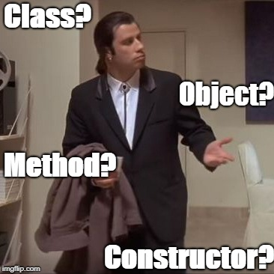
Class/Struct
Put all related things (data, functions) together
Represents objects in OOP
almost everything should belong to a class
No real difference except for default visibility, inheritance, …
class – by default everything private
struct – by default everything public
Internal things → private
protected if need access from a child
Read-only functions → const
const-correctness
Special methods (constructor, destructor, …)

Slide 98
Class Example
class calculator {
// by default everything is private
void sum();
void substract();
public:
calculator() { /* default ctor */ }
calculator(const std::string &str) () {
/* ctor */
}
void calc(const std::string &str);
void print_result() const;
private:
void multiply();
protected:
void init();
private:
};
calculator c; // no need for new!
c.calc("1+2-3");
c.print_result();
// calling non-default ctor
calculator c2("1+2-3");
c.print_result();
// creating a vector
std::vector<calculator> calcs;
can be used multiple times
semicolon at the end!

Slide 99
Class vs. Struct
Use class if the class has an invariant; use struct if the data members can vary independently
struct coordinate {
int x;
int y;
int z;
coordinate();
coordinate(int x);
coordinate(int x, int y);
coordinate(int x, int y, int z);
void set(int x, int y, int z);
};

Slide 100
Dynamic Array - std::vector<T>
Beware of time complexity
vector<bool> optimization
#include <vector>
int main() {
std::vector<int> vi{1, 2, 3, 4, 5, 6}; // [1, 2, 3, 4, 5, 6]
std::vector<float> vf(5, 0.0f); // [0.0, 0.0, 0.0, 0.0, 0.0]
std::cout << vi[3] << “ “ << vf.at(3) << std::endl; // access the 4th! element
std::cout << vi.size();
vi[3] = 100; vi.at(6) = 600; // access the 4th and 7th element
vf.push_back(100.0f); vf.emplace_back(200.0f); // insert at the end
vf.emplace_back(200.0f); // create element at the end
vf.insert(3, 300.0f); vf.emplace(3, 300.0f); // insert at the specific place
vf.emplace(3, 300.0f); // create element at the specific place
vi.pop_back(); // erase the last element
vf.erase(2); // erase the 3rd element
vi.clear(); // clear whole container
vi.reserve(10); // reserve space(=memory) for 10 elements
vi.resize(10); // actually create 10 elements using default ctor
}

Slide 101
3D Matrix for Integers – minimal API
ctor(), ctor(x, y, z)
set(x, y, z, value), get(x, y, z), print()
set_width(), set_length(), set_heigth(), get_width(), get_length(), get_height()
get_matrix(x), get_matrix(y), get_matrix(z)
get_vector(x, y), get_vector(y, z), get_vector(x, z)
clear() – set all values to 0 (zero)
fill_with_value(value) – set all values to a given value
num_zeros(), num_negatives(), num_positives();

Slide 102
3D Matrix for Integers - Hints
Think about the desing
array → matrix → 3D matrix → 4D matrix → … → XD matrix
Design simple first, then continue to the next level
No need to focus too much on performance yet
Focus:
Passing arguments: const-references, references, …
const functions
class design
Decomposition into functions
Function reusing
private/public

Slide 103
Programming in C++ - lab 1
https://fan1x.github.io/cpp21.html
tomas.faltin@matfyz.cuni.cz

Slide 104
Basic information
Email: tomas.faltin@matfyz.cuni.cz
Labs web: https://fan1x.github.io/cpp22.html
Lecture web: https://www.ksi.mff.cuni.cz/teaching/nprg041-web/
Mattermost
Invite link in SIS/Notice-board
Channel: `nprg041-cpp-faltin`
Gitlab
https://gitlab.mff.cuni.cz/
https://gitlab.mff.cuni.cz/teaching/nprg041/2022-23/faltin

Slide 105
Communication is the key
Don’t be afraid to ask
Be proactive
via email
on Mattermost (instant)
DM if related to you only
Into a channel if others can benefit from it
If you struggle with something
If you feel like you might miss a deadline

Slide 106
Labs credit
Submitted homeworks before Sunday midnight (Sunday 23:59)
to Gitlab
Even if not attending!
Won’t be graded, for feedback only
Two large homeworks in ReCodex (total 40 points)
Points are included in the final score from the course
Smaller HW – 15 points, ~November
Larger HW – 25 points, ~December
Software project
Topic must be approved by 27/11/2022
POC: 18/12/2022
First submission: 02/04/2023
Final submission: 28/05/2023
All the steps typically mean multiple iterations within multiple days. If you wait for the last minute, there is a chance you won’t make it

Slide 107
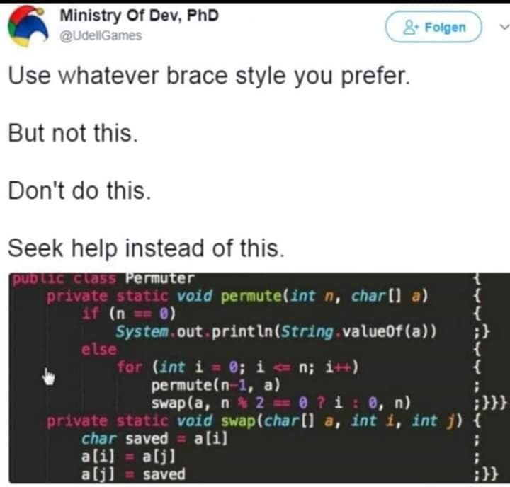
Code Requirements - Consistency
Consistency
Be consistent within the code
keep a single code style

Slide 108
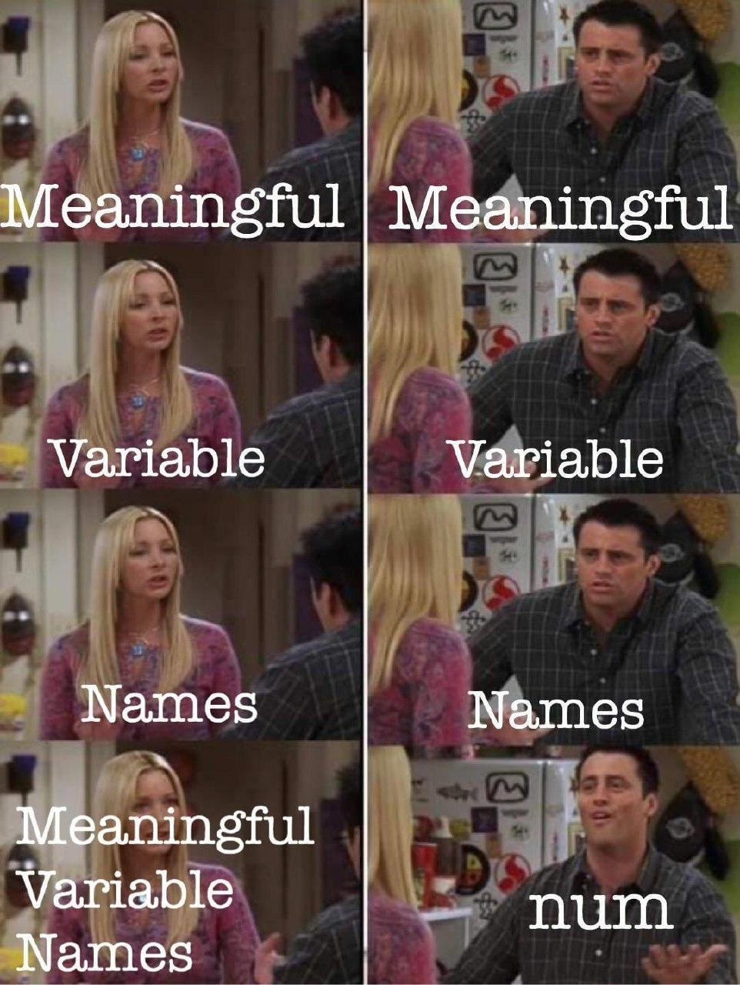
Code Requirements – Readability
Code doesn’t contain commented/dead parts
Code should be readable on its own
Comment complicated code

Slide 109
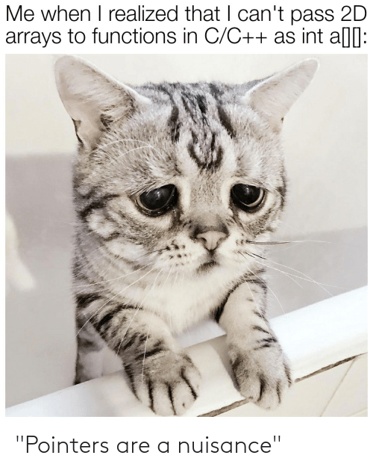
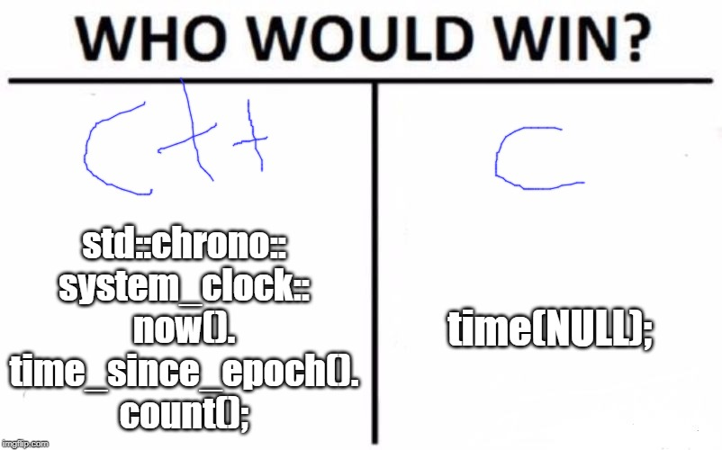
Code Requirements – Safe, Modern
Prefer using modern constructs
Additional safety
Maybe performance
E.g., prefer `std::vector<int>` to `new int[]`

Slide 110

Code Requirements – Working
OFC, if the code is not working, all the above points are not that important
they will help you with debugging at least ☺

Slide 111
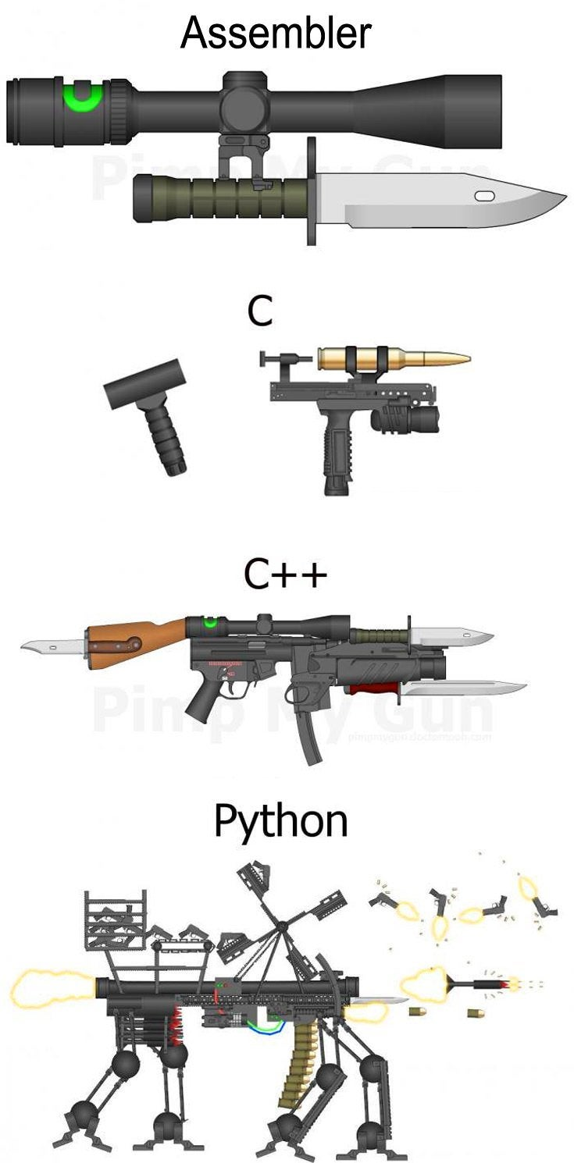
Why C++
“C makes it easy to shoot yourself in the foot. C++ makes it harder, but when you do, it blows away your whole leg.” -- Bjarne Stroustrup
“It was only supposed to be a joke, I never thought people would take the book seriously. Anyone with half a brain can see that object-oriented programming is counter-intuitive, illogical and inefficient.” -- Stroustrup C++ ‘interview’ (https://www-users.cs.york.ac.uk/susan/joke/cpp.htm)

Slide 112
Working Environment
Use anything you like ☺
IDEs
Visual Studio
License for students at https://portal.azure.com/...
VS Code
Clion
Code::Blocks
Eclipse
…
Compilers
MSVC, GCC, Clang+LLVM, ICC, …

Slide 113
C++ (interesting) links
Reddit, Slack, …
https://en.cppreference.com/w/
http://www.cplusplus.com/
http://isocpp.github.io/CppCoreGuidelines/CppCoreGuidelines
https://www.youtube.com/user/CppCon
https://isocpp.org/
http://www.open-std.org/jtc1/sc22/wg21/docs/papers/
https://godbolt.org/
…

Slide 114
Learning C++
C++ in 100 seconds: https://youtu.be/MNeX4EGtR5Y
C++ in 31h: https://youtu.be/8jLOx1hD3_o

Slide 115
Hello World
#include <iostream>
#include <string>
int main() {
std::string name;
std::cin >> name;
std::cout << "Greetings from " << name << std::endl;
return 0;
}

Slide 116
Hello World
Include the libraries which implements the used STL constructs (string, cin, cout)
#include <iostream> #include <string> int main() { std::string name; std::cin >> name; std::cout << “Greetings from ” << name << std::endl; return 0; }
The main entry point/function for all programs. The execution starts here
Declare a variable of type string
Read from standard input (keyboard)
Write to standard output (screen)
All the STL constructs live inside `std` namespace

Slide 117
Compilation
c++ --version
c++ is a compiler, here GCC
c++ hello_world.cpp -o hello_world
Compile program into `hello_world` executable (using default settings)
c++ -Wall -Wextra -Werror -O3 -std=c++2b hello_world.cpp -o hello_world
Wall: Show all warnings
Wextra: Show additional extra warnings
Werror: Thread all warnings as errors
O3: level of optimizations
std=c++2b: Used C++ standard
Or use IDE ☺

Slide 118
More Complex Program
#include <iostream>
#include <string>
#include <vector>
using namespace std;
void pretty_print(const vector<string>& args) {
// ... args[i]
}
int main(int argc, char** argv) {
vector<string> args(argv, argv+argc); pretty_print(args);
return 0;
}

Slide 119
More Complex Program
Include the whole std namespace
#include <iostream>
#include <string>
#include <vector>
using namespace std;
void pretty_print(const vector<string>& args) {
// ... args[i]
}
int main(int argc, char** argv) {
vector<string> args(argv, argv+argc); // Wrap arguments
pretty_print(args);
return 0;
}
Passing the argument by (const) reference
Arguments of the program on the command line
Number of arguments
Transform “magically” the arguments into C++ array of strings

Slide 120
Functions And Parameters
int get_max(int v1, int v2) {
return v1 > v2 ? v1 : v2;
}
int get_max1(const vector<int> &ints) {
int max = std::numeric_limits<int>::min();
for (int x : ints) {
max = get_max(x, max);
}
return max;
}
bool get_max2(const vector<int> &ints, int &max) {
max = std::numeric_limits<int>::min();
for (int x : ints) {
max = get_max(x, max);
}
return !ints.empty();
}
std::tuple<bool, int> get_max3(const vector<int> &ints) {
int max = std::numeric_limits<int>::min();
for (int x : ints) {
max = get_max(x, max);
}
return { !ints.empty(), max };
}

Slide 121
Functions And Parameters
read-only input parameter
Most of the types (string, vector, …) → use const-reference - const &
int get_max(const vector<int> &ints)
For small numeric types (int, float, double, …) → use direct parameter
int get_max(int v1, int v2)
output parameters
Single output parameter → use return value
int get_max(const vector<int> &ints)
Few output parameters → use tuple/pair/structure
std::tuple<bool, int> get_max(const vector<int> &ints)
Many output parameters → use reference - &
bool get_max(const vector<int> &ints, int &max)

Slide 122
Homeworks
Hello World
A greeting program (use names from arguments)
`hello.exe Adam Eve` → `Hello to Adam and Eve`
What is inside args[0]?
Summation of numbers from arguments
`sum.exe 1 2 3 4 5` → `15`
`stoi(), stod(), stoX()`
Functions for transformation from string to <something>
A simple calculator (only for operations +-)
`calc.exe 1+2+3-4` → `2`
to Gitlab
The previous programs are not needed, they should give you a lead

